Slide 1
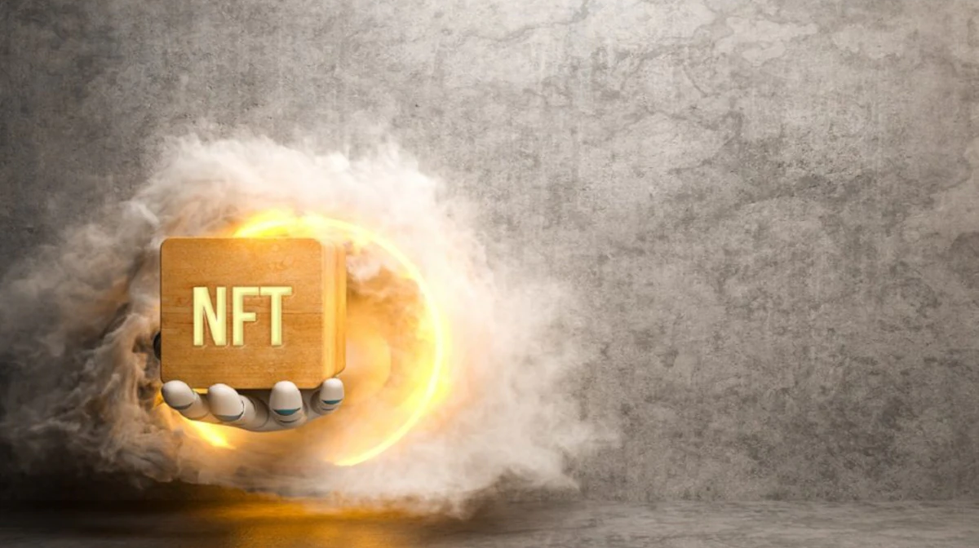
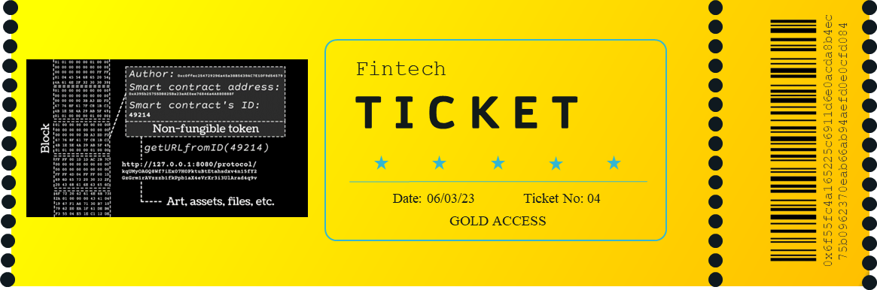
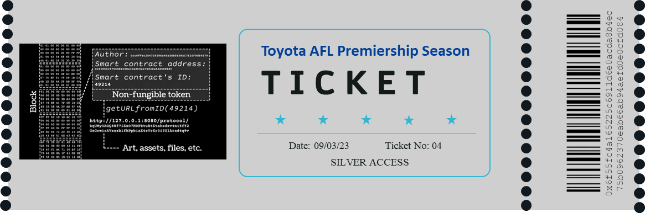
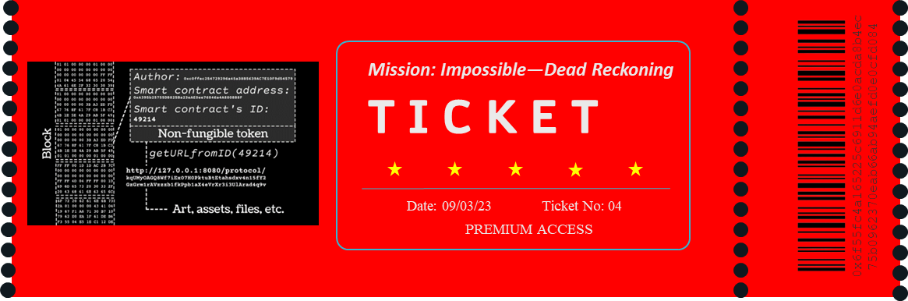
NFTix
Project group 4
Anti-scalping blockchain based event Ticketing system
ix
Guy Adam
Venkata Nagothi
Sreeni Patnaik

Slide 2
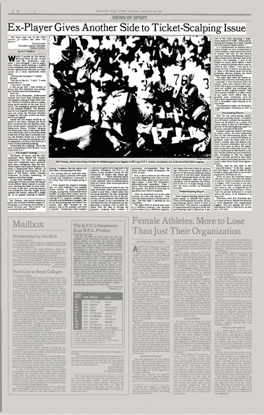
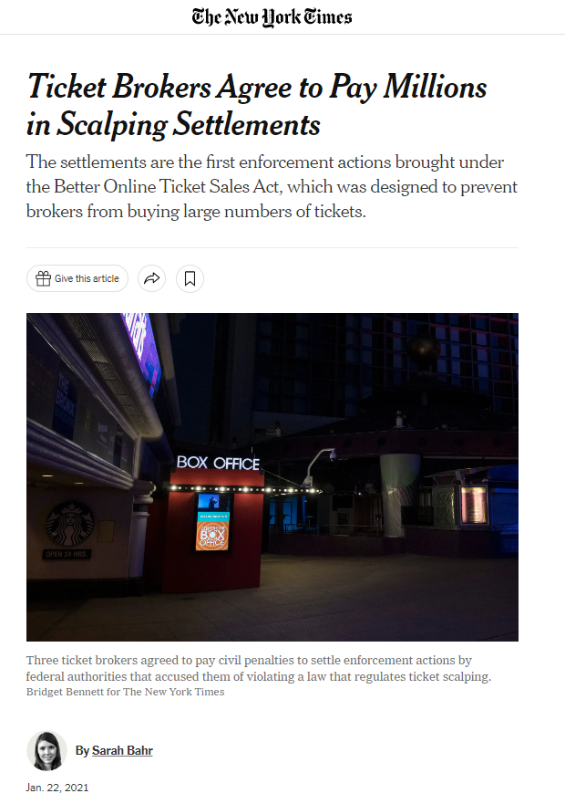
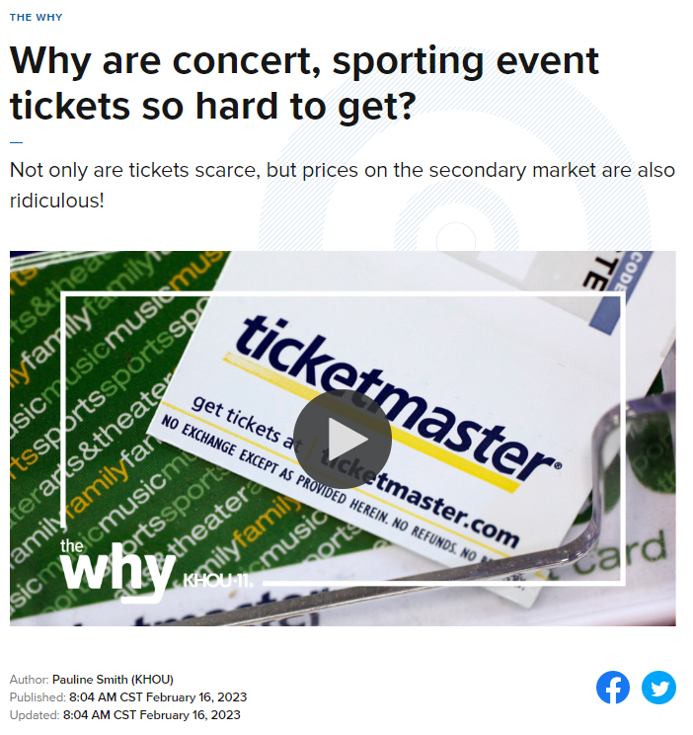
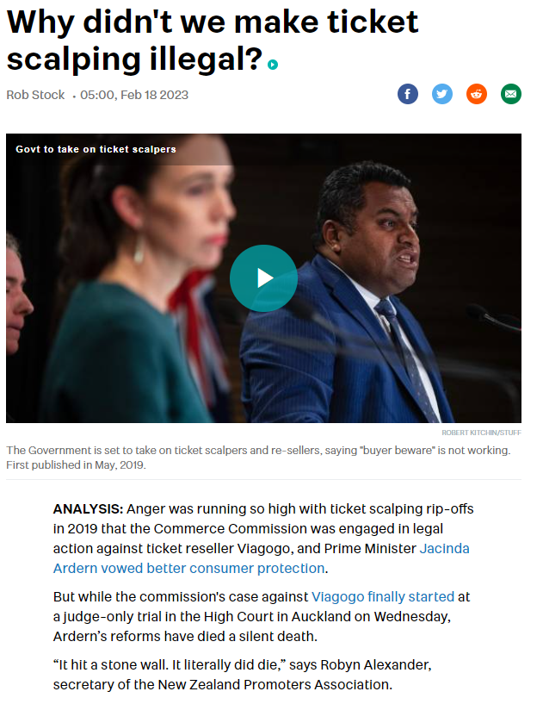
Ticket scalping is a significant issue
Ticket scalping can lead to higher ticket prices, reduced accessibility, fraud and counterfeiting, and negative impacts on the event industry. For example, in 2019, it was reported that a scalper had made around $18 million in profits from selling tickets to the Broadway show "Hamilton."

Slide 3
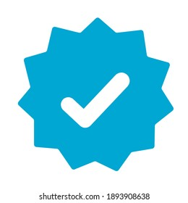


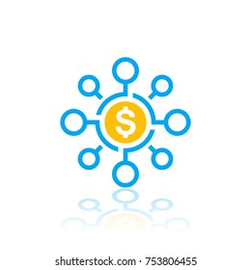
Authenticity
Non Fungible Token
(NFT) Ticketing
NFT ticketing ensures that tickets are unique and cannot be duplicated or counterfeited. This helps prevent ticket fraud and ensures that the tickets sold are legitimate.
Transparency
NFT ticketing are a transparent way to track the entire lifecycle of a ticket. This includes information such as when the ticket was created, who bought it, and how many times it was transferred.
Event tickets using blockchain technology
The objective of this project is to build a resilient Non-Fungible Event ticketing application that has one-of-a-kind tokens stored on blockchain and can be transferred from the issuer to the buyer’s wallet. The organizers of the event can mint as many tickets as they need.

Accessibility
NFT ticketing can make it easier for fans to access and purchase tickets. Since the tickets are stored digitally, they can be easily distributed and sold across the globe.

Revenue Sharing
NFT ticketing enables event organizers to implement revenue-sharing models that can benefit both artists or performers. Blockchain can distribute royalties to the relevant parties based on predetermined rules.

Slide 4
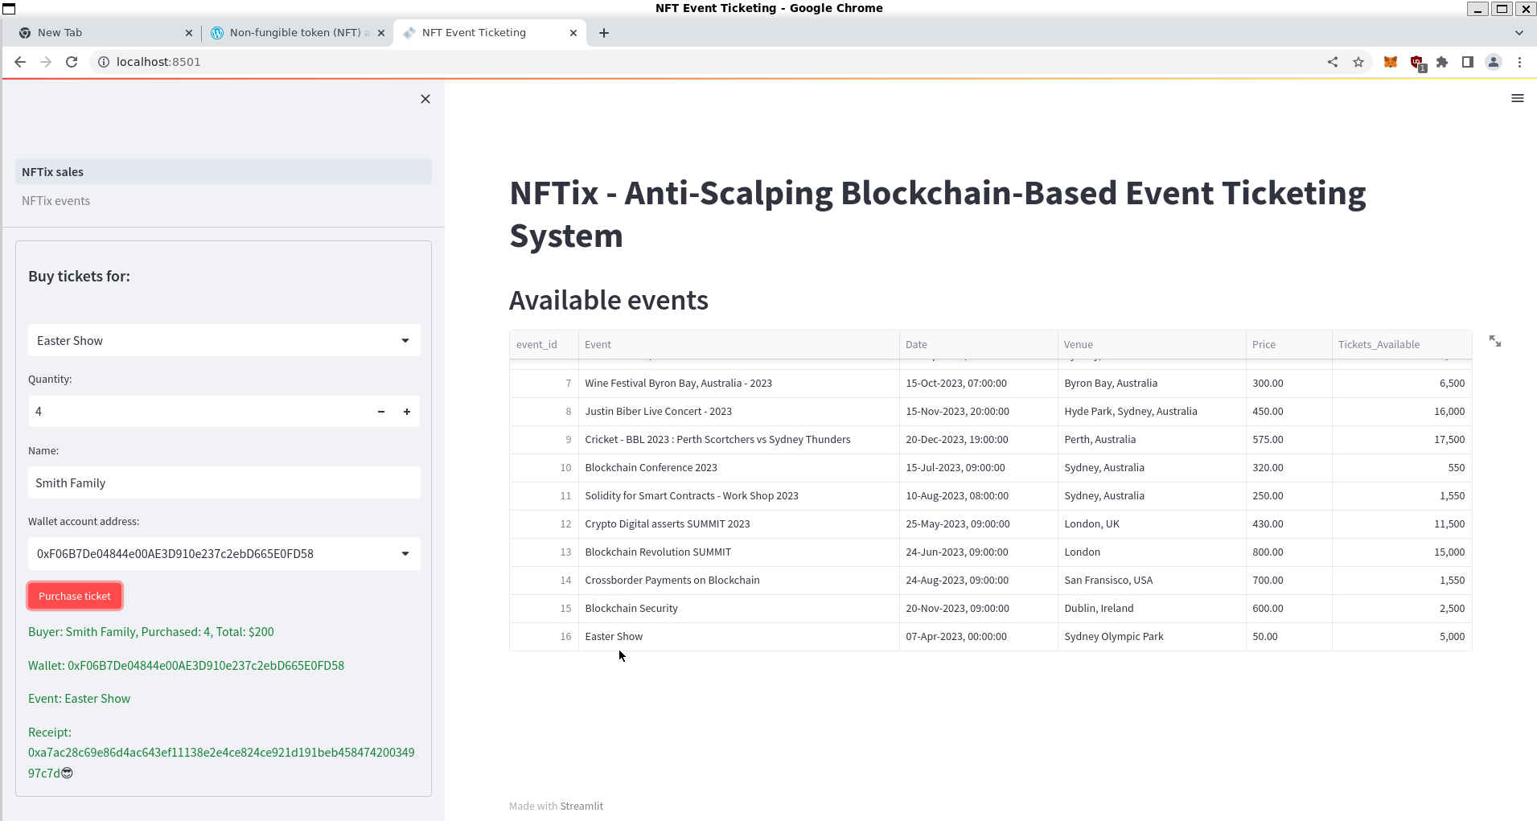
Application Workflow
1 | Event Organizer | Event organizer inputs event details in Streamlit application Once saved, event details are pushed to the PostgreSQL database in the backend Flexible to edit event details in-case of any changes to the events.
2 | Event Participant | Event participants login to view registered events and schedules Check available tickets and cost to purchase tickets Choose the event, number of tickets and select a wallet to purchase ticket
3 | Solidity | Once submitted to purchase the transaction is executed though the algorithm written on Solidity. Solidity Registers ticket Purchase on Ethereum Blockchain and generates a unique hash value as a receipt to uniquely identify the purchase A successful transaction will make a database call to store the event_id, transaction_id and Buyer's contract Address in a table called "nftix.events_sales" table.

Slide 5
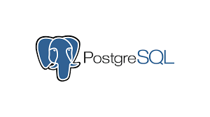
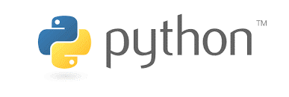

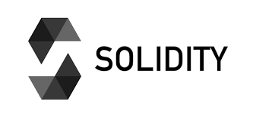
Technical Architecture
NFTix technical architecture has four components. Postgre SQL as database, Python for backend processing, Streamlit for front end application interface and Solidity to write the NFT smart contract
01
02
03
04
Postgre SQL
Python
Streamlit
Solidity
Open-Source relational Database to store and retrieve event data by receiving calls from Streamlit/Python on ticket purchases. We used "psycopg2" Python module in Python for query execution on PostgreSQL database
Python used to write the backend code for the application. It interacts with PostgreSQL database and Streamlit to retrieve, process and store data.
Streamlit application as a frontend accepts user inputs for Events addition from event organizers and purchase event tickets from buyers.
Streamlit interacts with Python and Solidity for each transaction
Solidity is used to write NFT smart contract on Ethereum blockchain. It has the business logic for event additions and ticket purchasing on the blockchain. Application uses Ganache to test and deploy the smart contract locally before deploying on main Ethereum network.

Slide 6
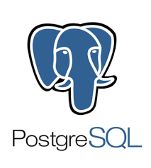
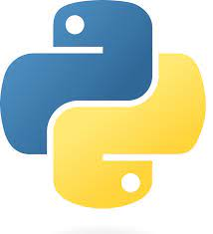

Dataflow
Events Table
Events Table
The application uses PostgreSQL database to store event details and transaction information for ticket purchases. The database has a "nftix" schema with two tables: "events" and "event_sales", which respectively store details of upcoming events and ticket purchases.
The Streamlit front-end interacts with both Python and Solidity.
Python interacts with the database and Streamlit to store and retrieve data, and also pushes transaction details to the database once a ticket purchase is successful.
Solidity is used to execute the actual ticket purchases on the blockchain, and Ganache is used as a test wallet for the purposes of the application.
Events Table
psycopg2
Frontend
Events Table
Events_Sales
Backend
NFT Smart Contract

Slide 7
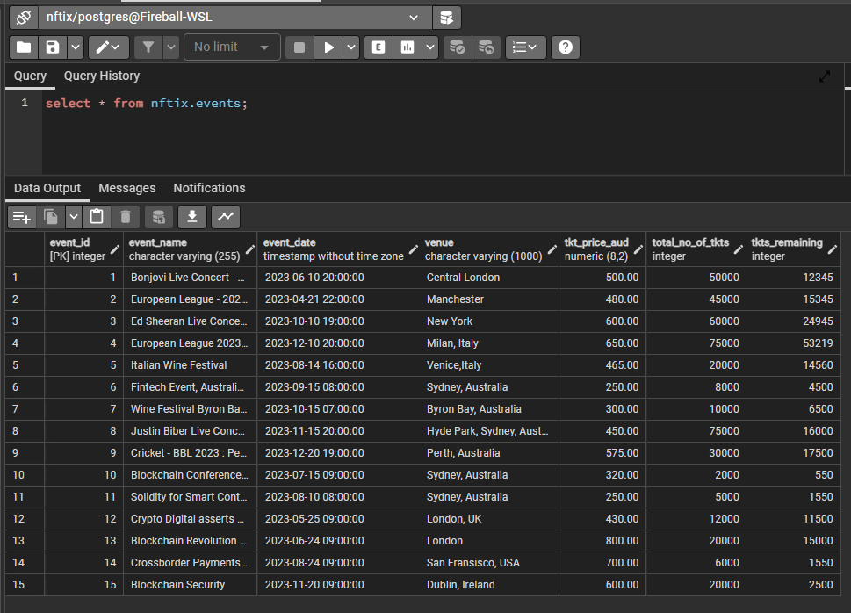
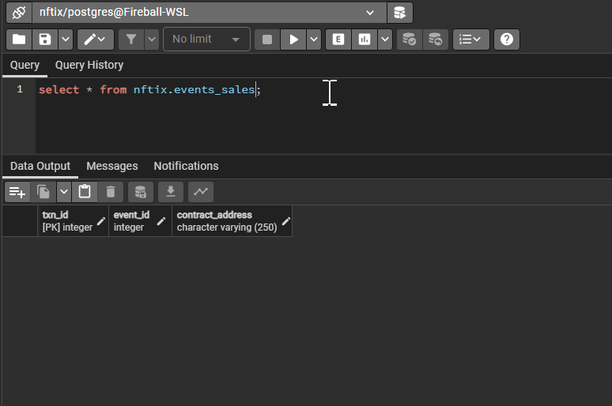
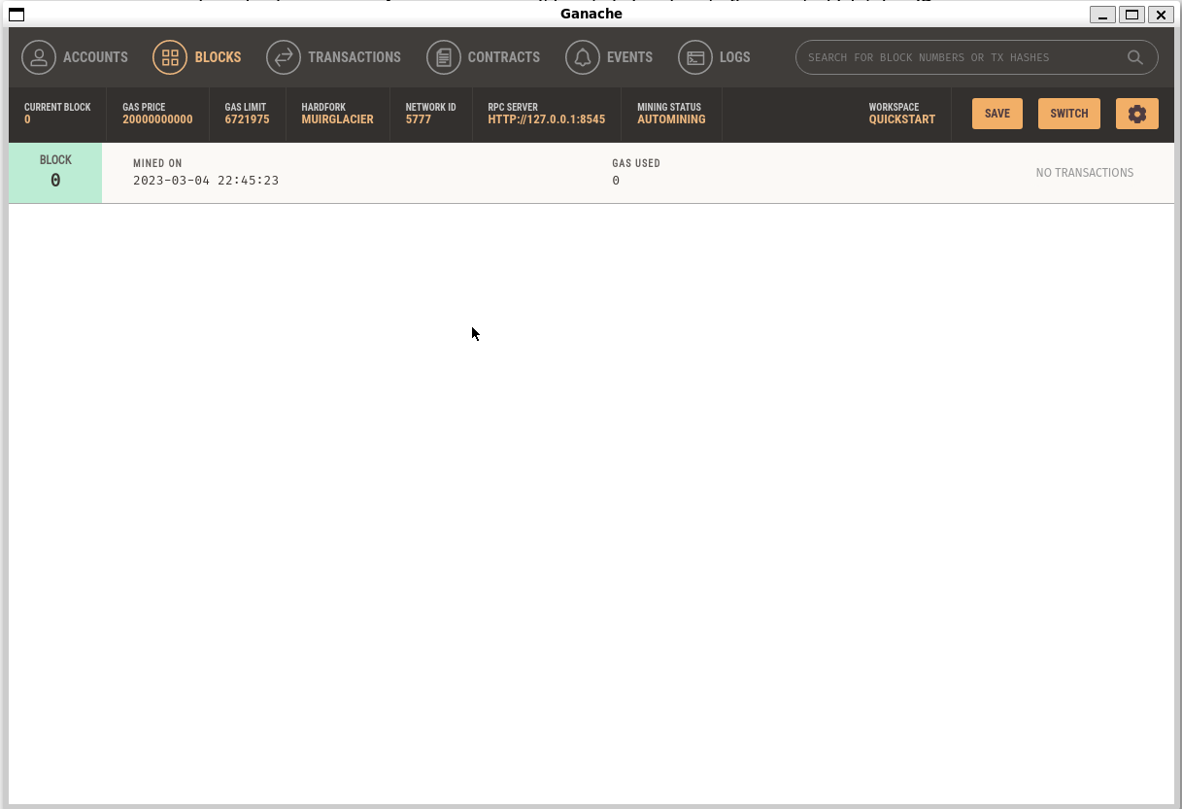
Our Approach
1
2
3
Events Table
Events Sales Table
Ganache Genesis Block
Events Table created in Postgre SQL that has 15 events recorded showing ticket prices, total number of tickets available and Tickets remaining post purchase
Event Sales Table that will record ticket purchase records consisting of buyer hash address, event ID from events table and create a transaction ID for the sale
Ganache initial block showing no transactions but will be used for future transactions

Slide 8
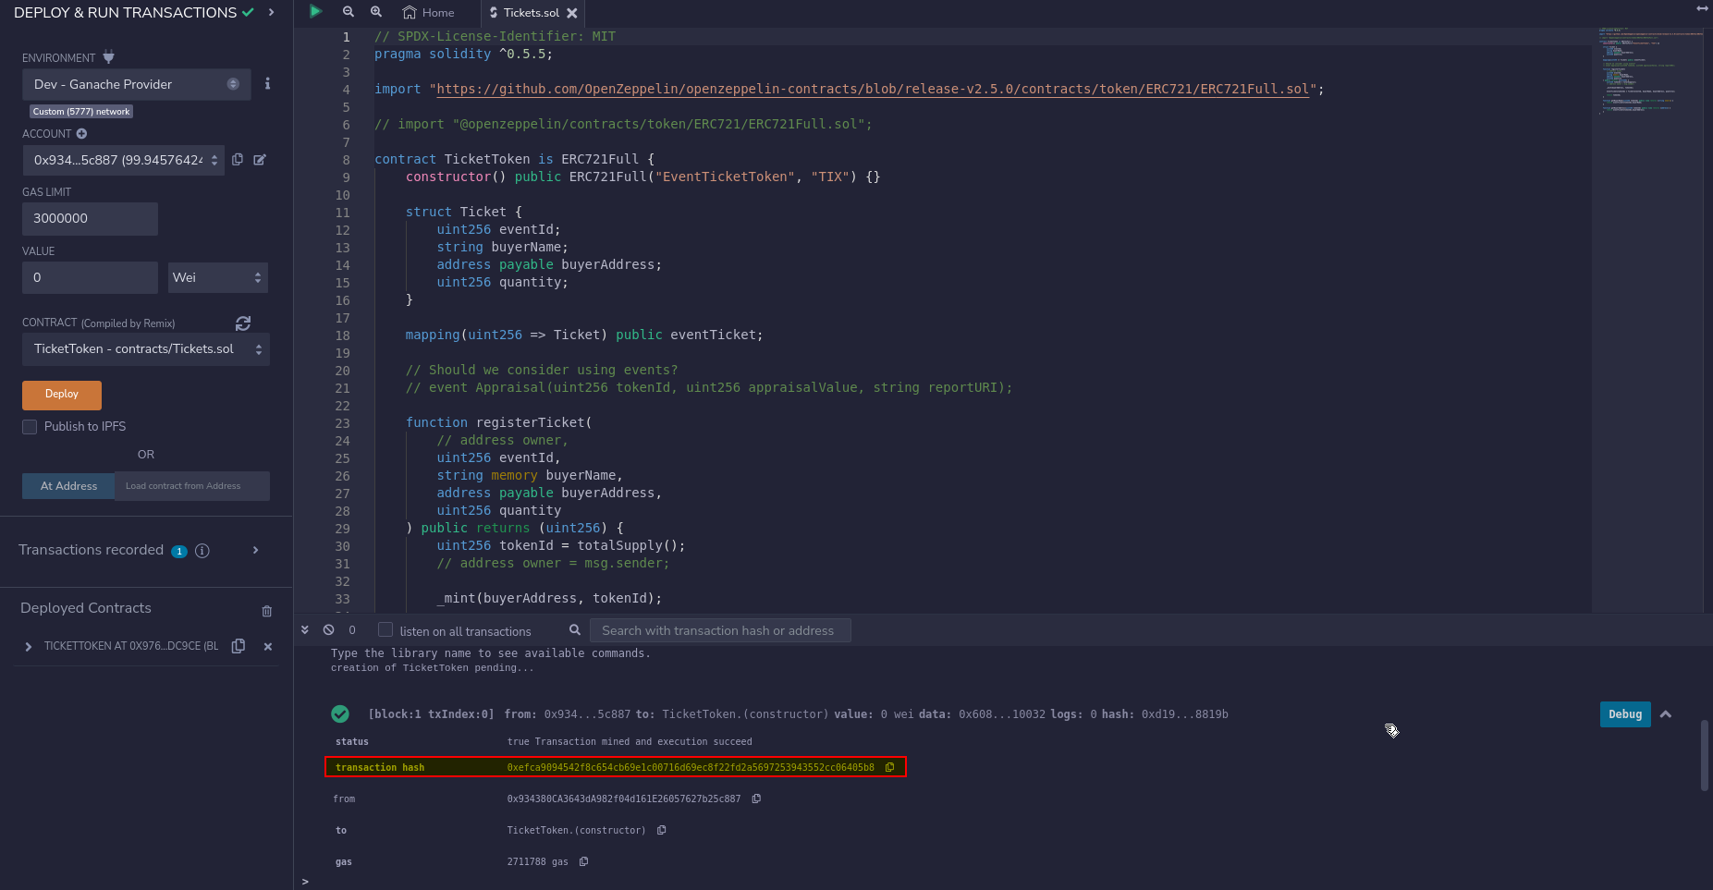
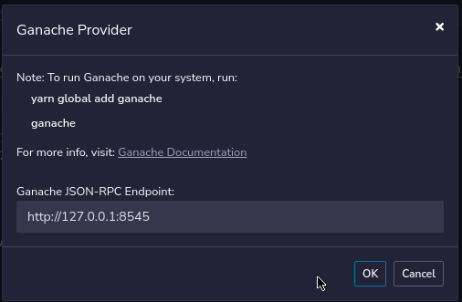
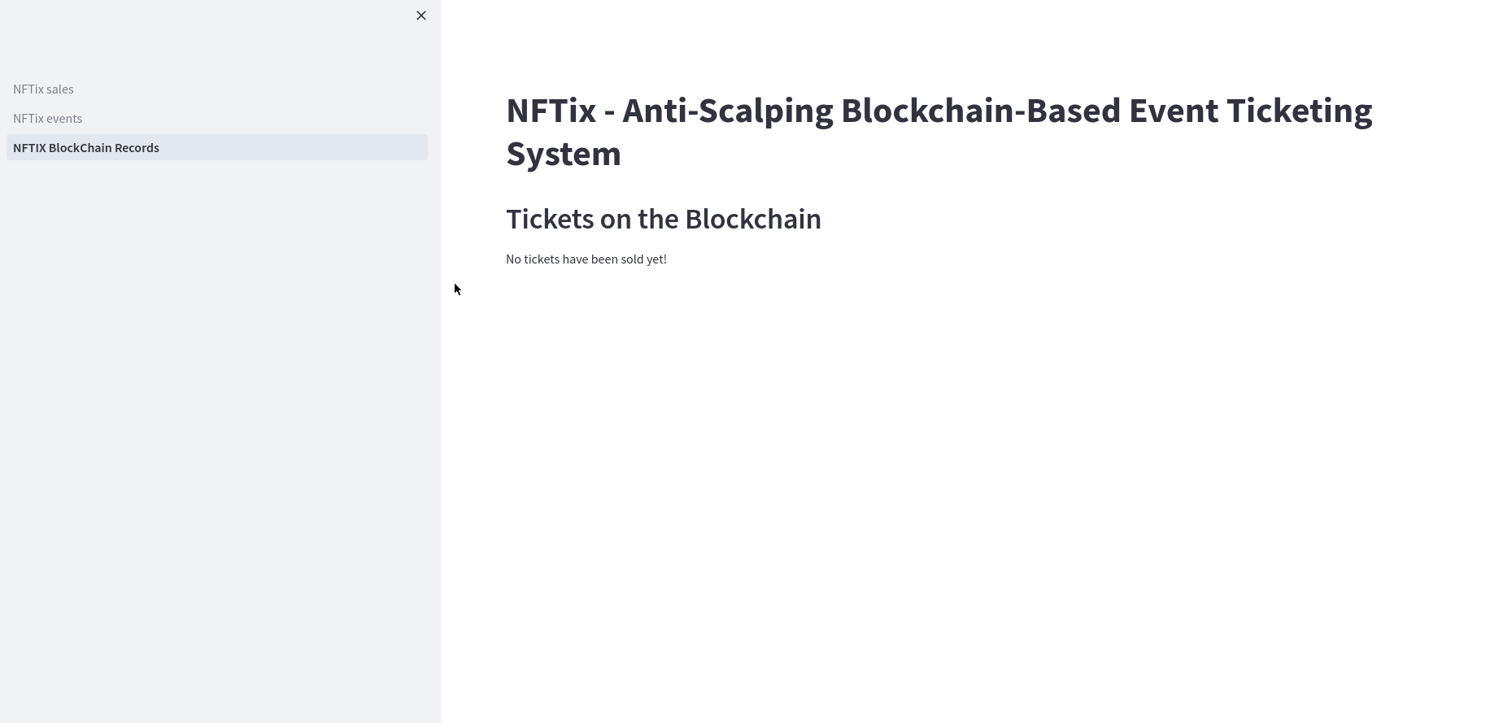
Our Approach contd..
6
5
4
Ganache Contract
Deployment
Blockchain Streamlit
Blockchain records page on Streamlit to show ticket blocks minted with buyer name , buyer hash address and the number of tickets bought
Ganache address for contract deployment
Ganache Contract Deployment
Contract code in Solidity for Ganache Contract Deployment

Slide 9
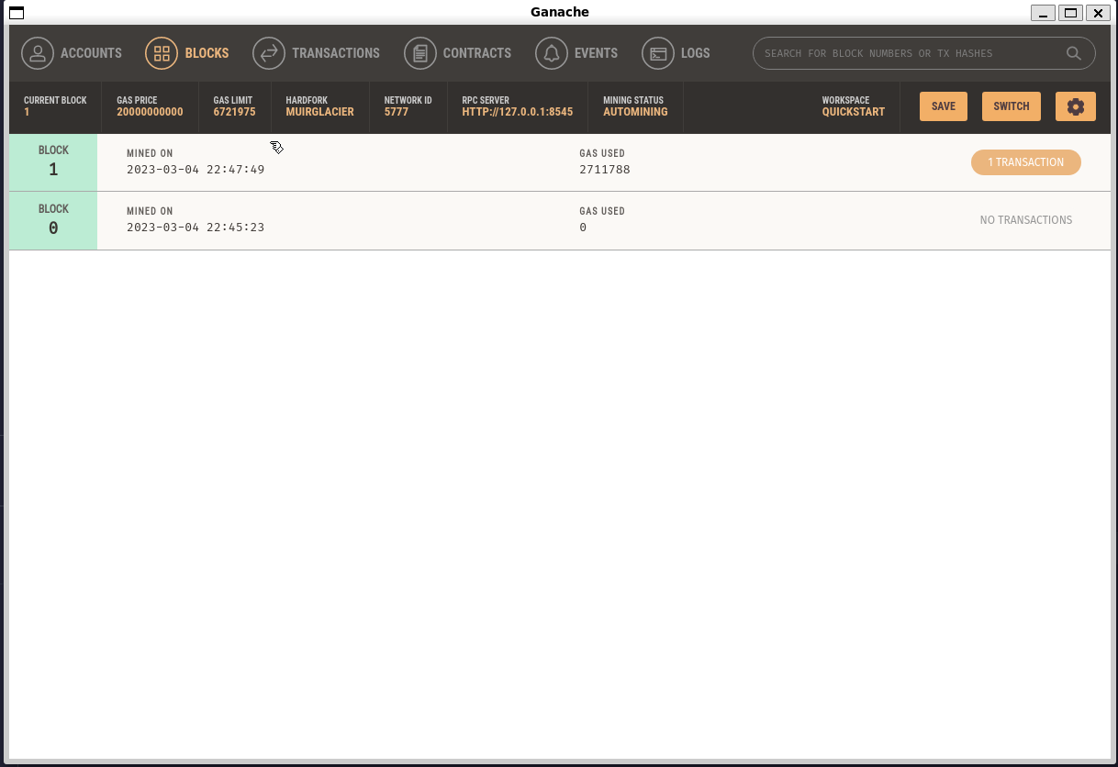
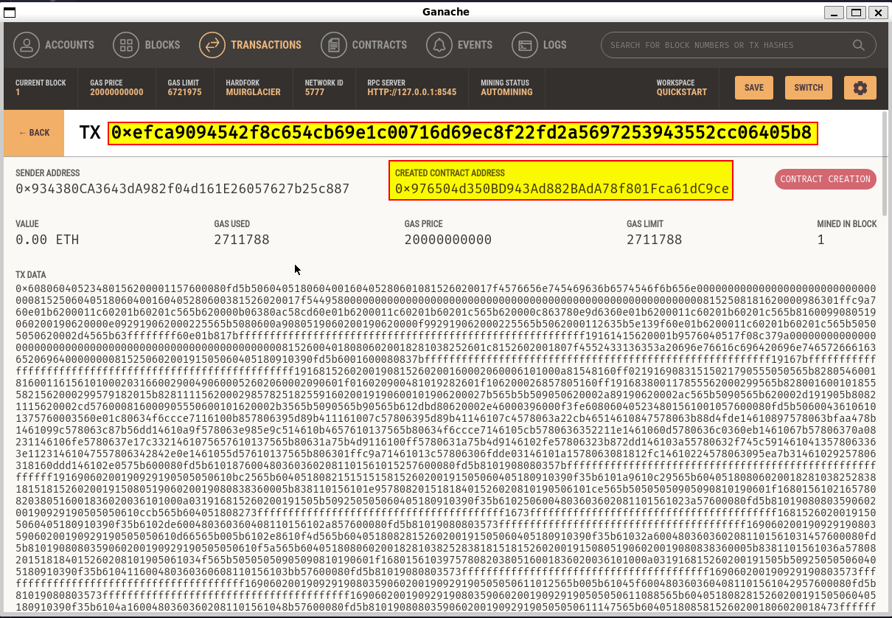
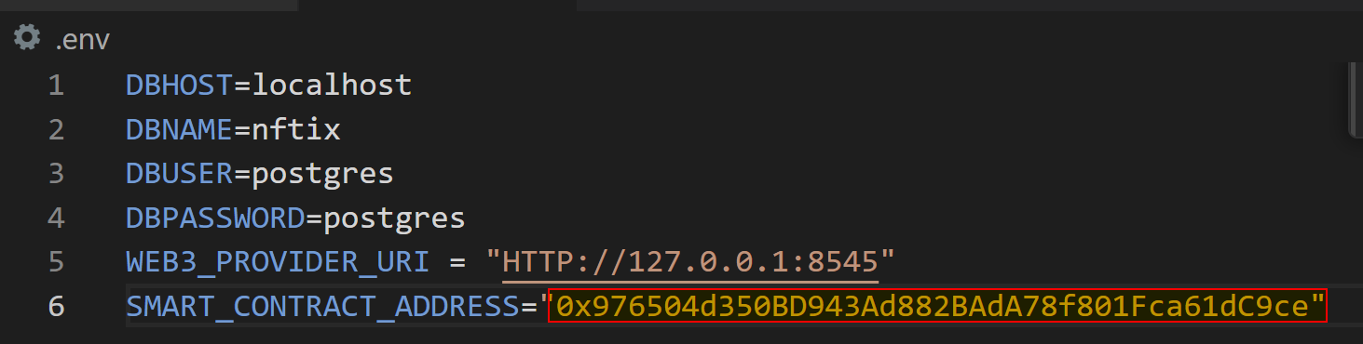
Our Approach contd..
7
8
9
Ganache Contract Deployment
Ganache Transaction
Update .env file with
contract Address
First blocked minted for the contract deployment
Transaction hash for the Block with the Contract Address
Contract address from step 8 is used to update .env file that will be used for future purchase transactions

Slide 10
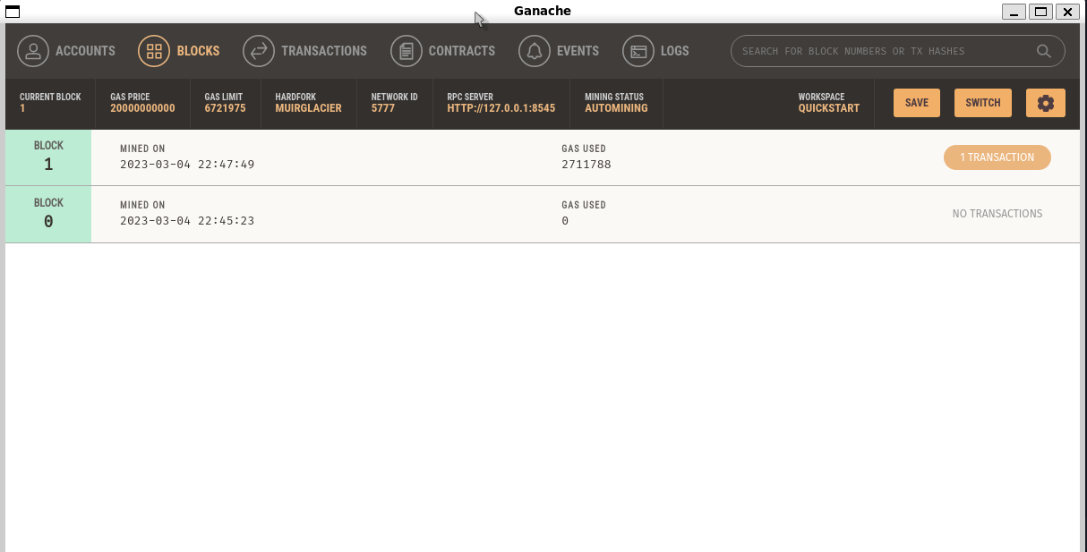
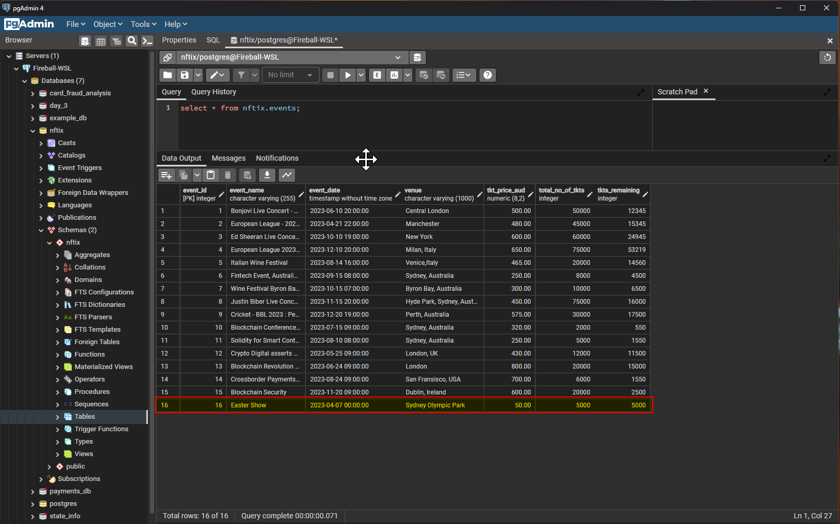
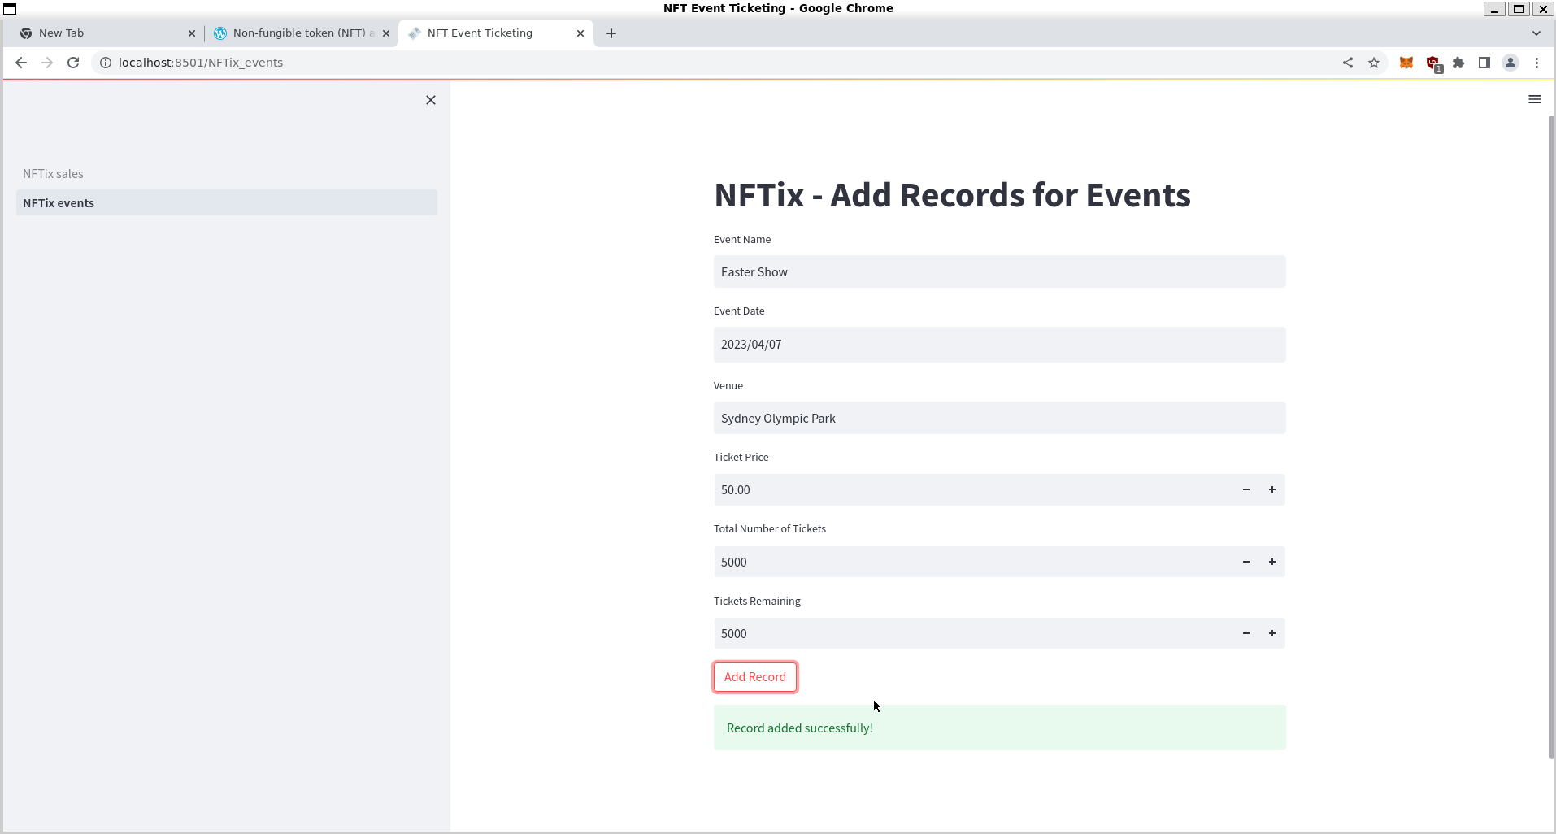
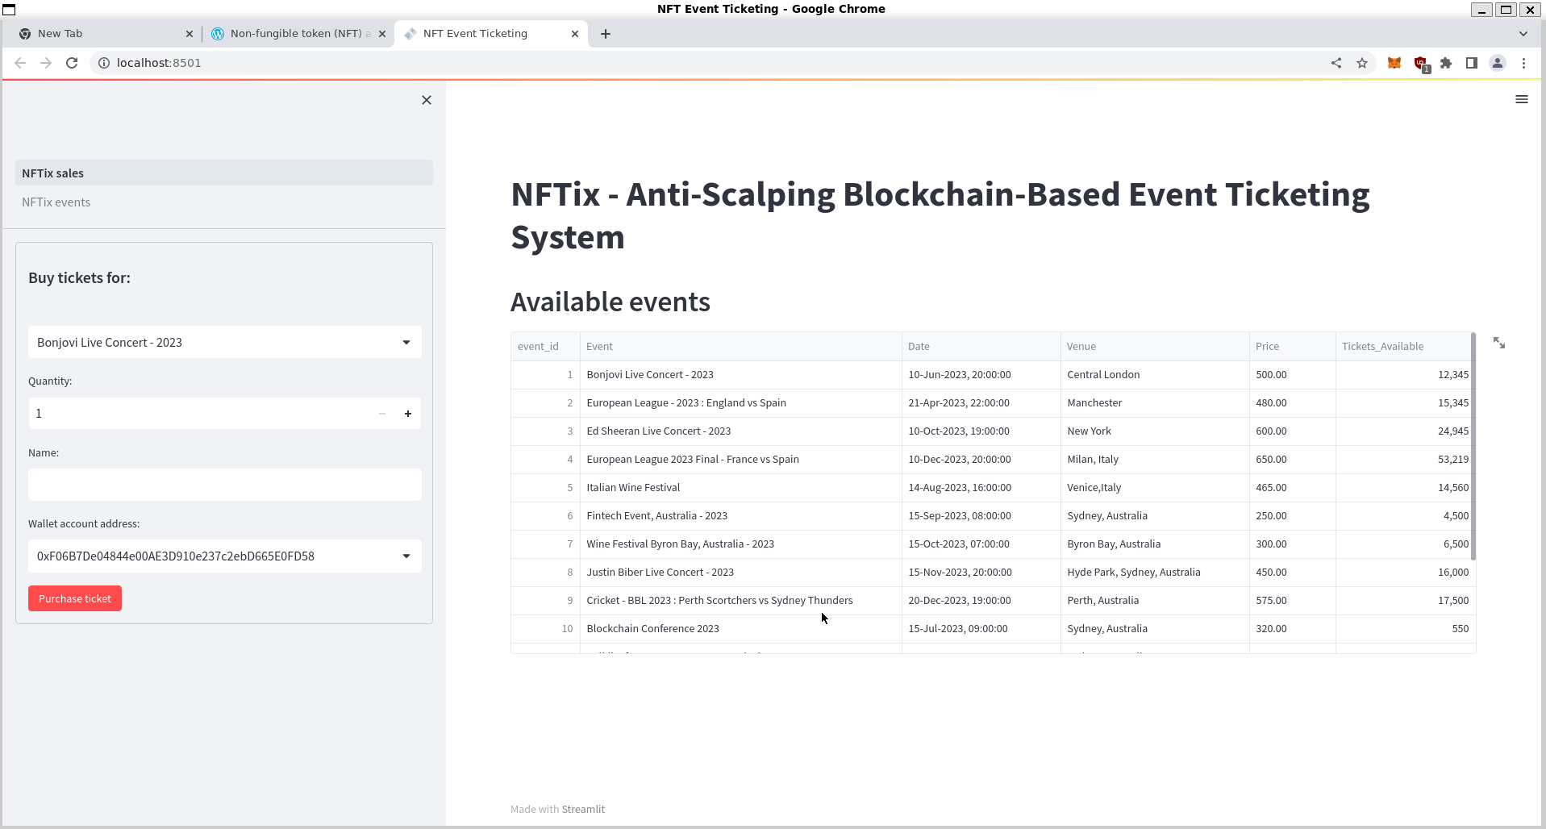
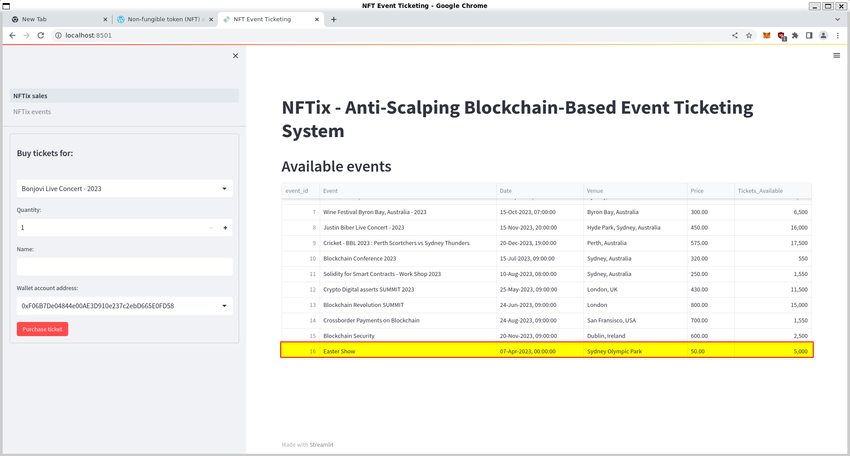
Our Approach contd..
12
11
10
Adding Event on Streamlit
Organizer adds records in Streamlit for new Events with information about Event Name, event date, ticket price, total number of tickets available, and total tickets available. The record is added to PostgreSQL database from Step 1
Ganache and Streamlit
before Transaction
Record added to PostGre SQL
Ganache blocks showing only one block mined before the first transaction in the next step
The record from Step 10 is added to Events Table in Post gre SQL and shows in Events list of Streamlit

Slide 11
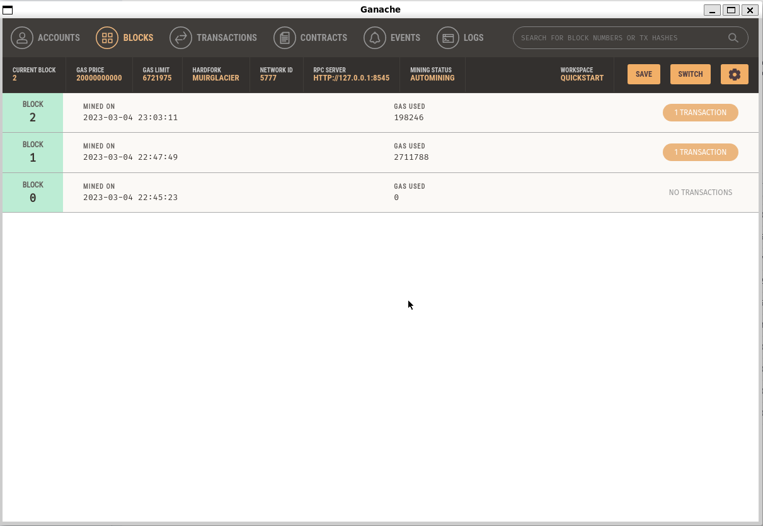
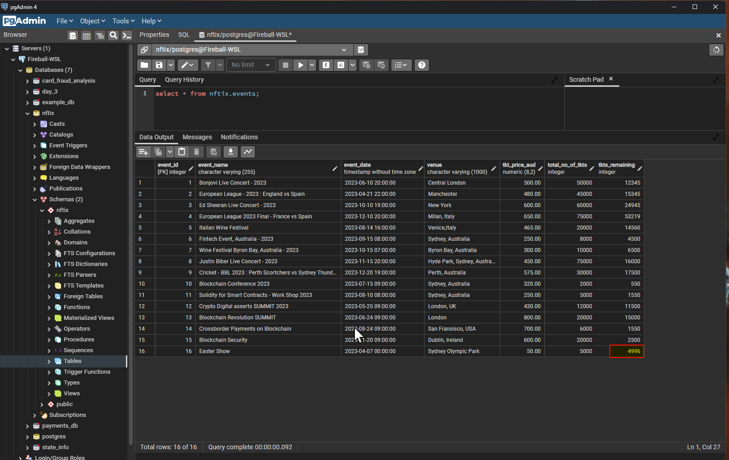
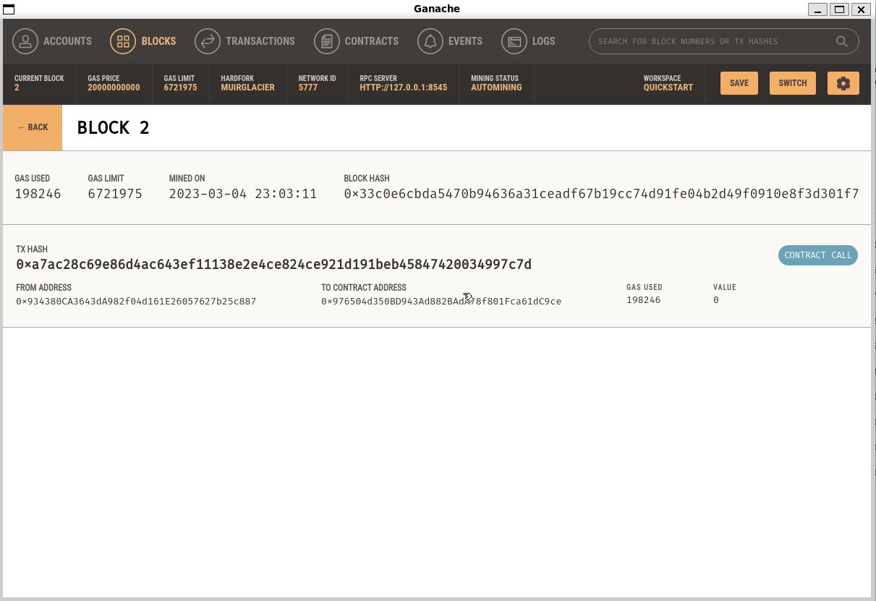
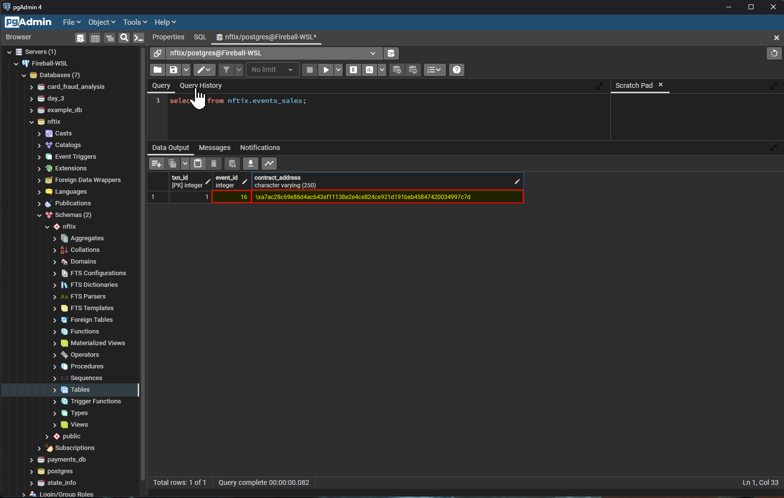
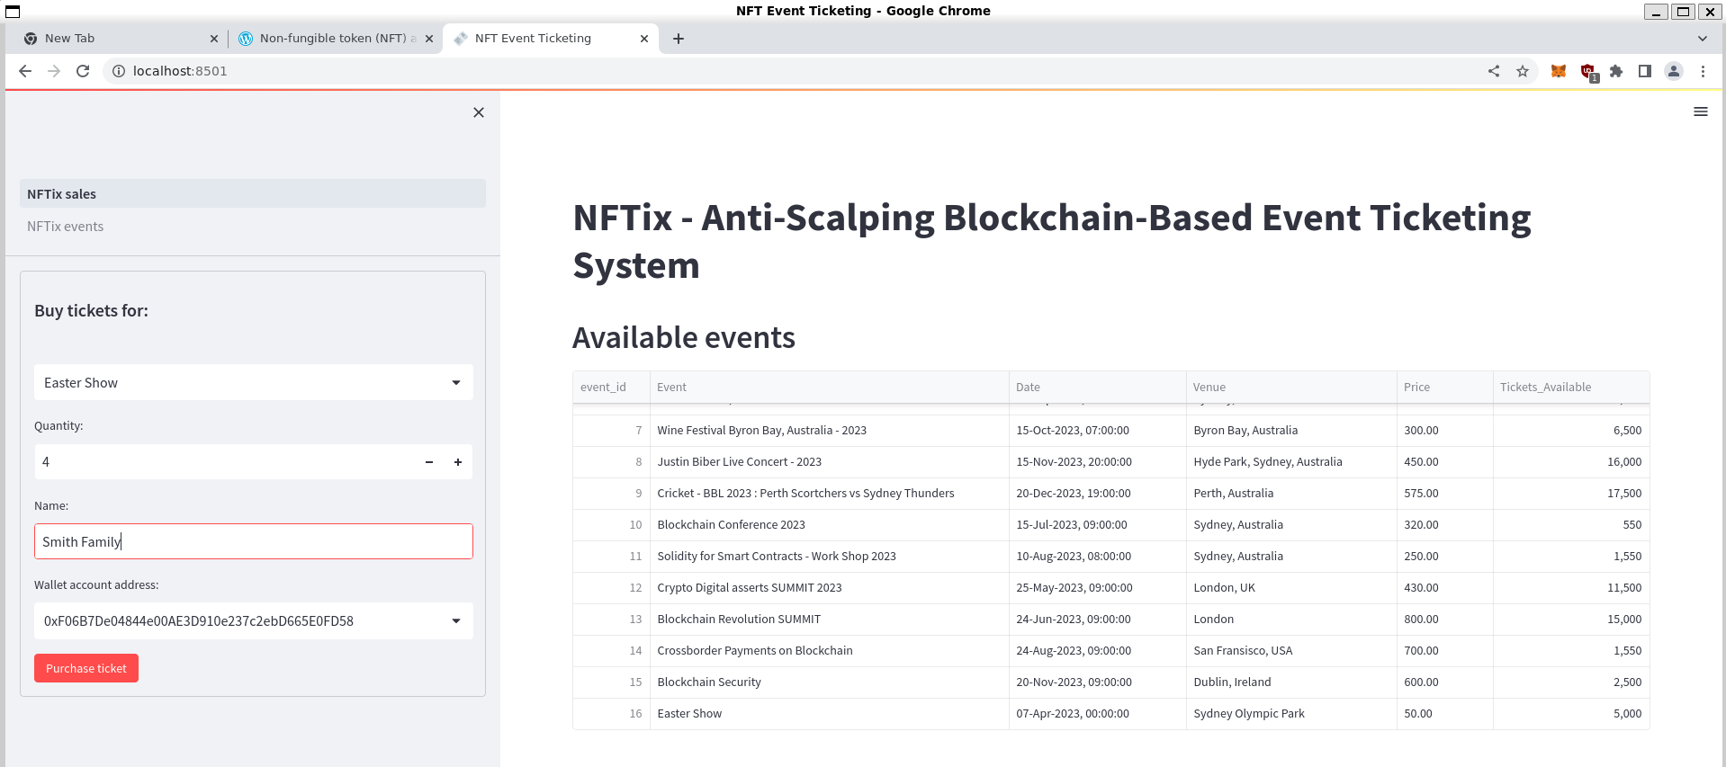
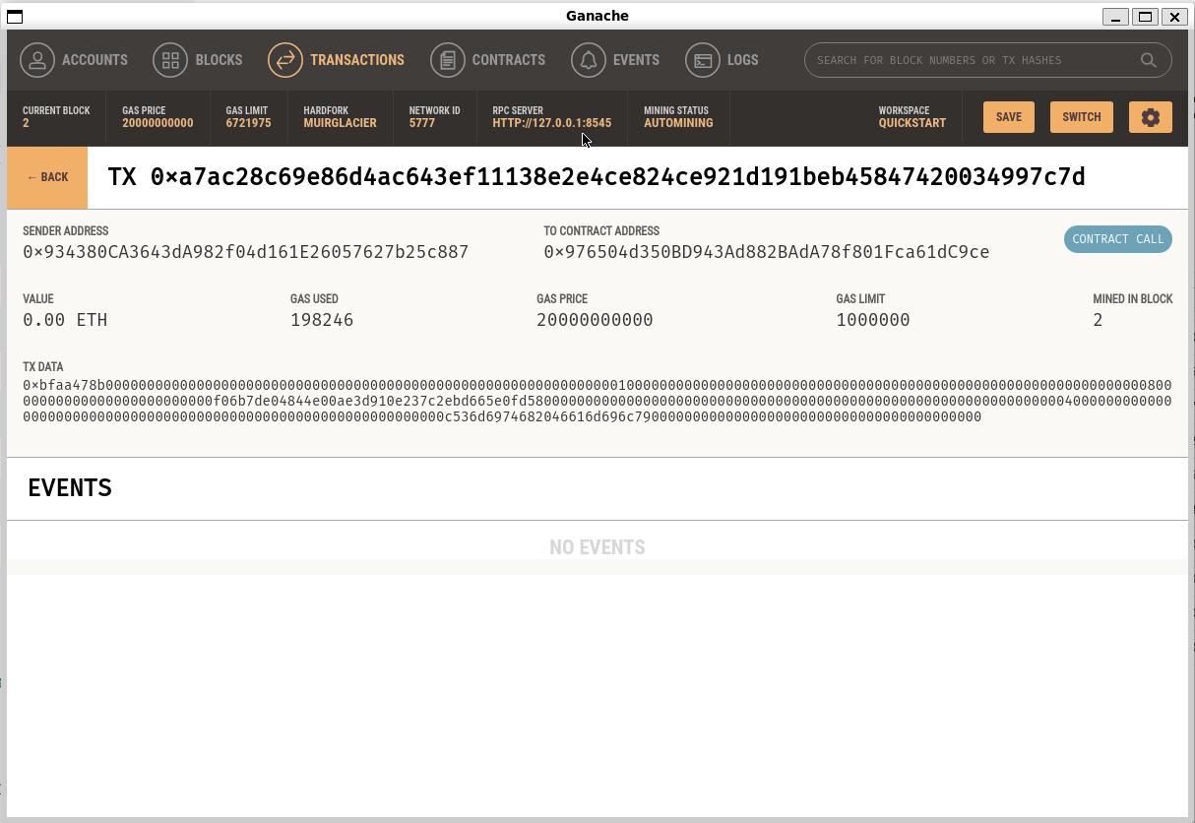
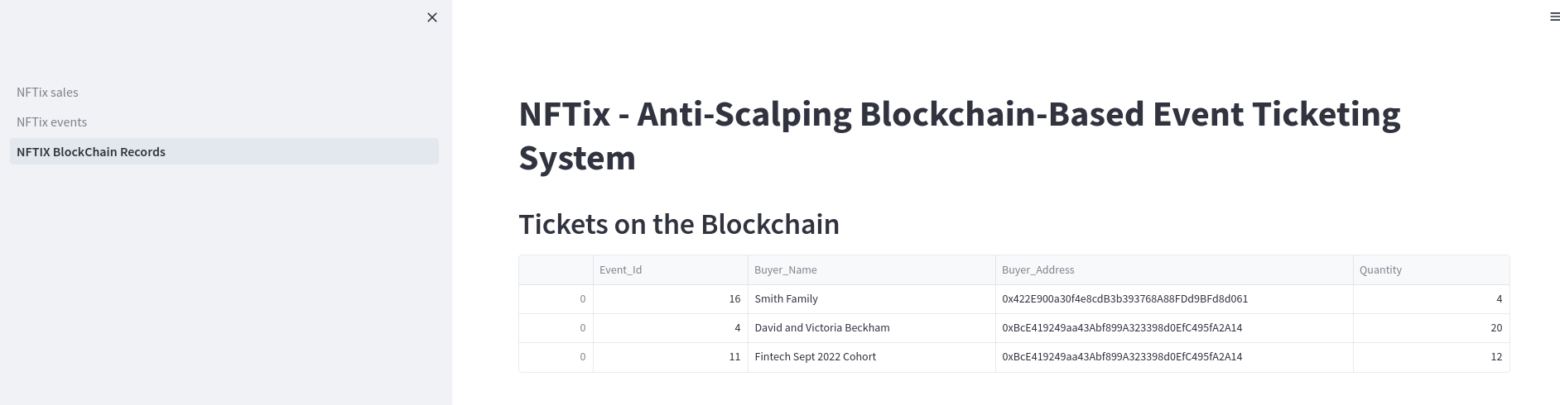
Our Approach contd..
13
14
15
Ganache after a Transaction
Postgre SQL
Ganache has block 2 mined with the first transaction , showing the transaction hash and contract address
Post first transaction, Postgre SQL has events table updated with tickets remaining and sales table with contract address

Slide 12
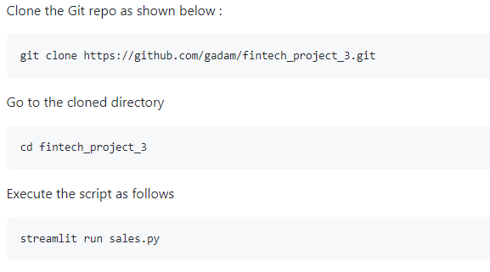
Dependencies and Script Execution Process
Dependencies
To ensure the code executes well, below are the pre-requisites and dependecies to be full-filled :
A PostgreSQL database must be installed and must be running on port 5432
Login to the PostgreSQL database and run the following script so that the database is created with the required schema, tables and the data
psql -p 5432 postgres -U postgres\i FintechProj3_DB_build.sql
Ensure "Streamlit" is successfully installed
Ensure "psycopg2" module is successfully installed
Ensure Web3==5.17.0 is successfully installed
Script Execution

Slide 13
Results and conclusions from the analysis
<Guy please add a line here >
Notes:
Include relevant images or examples to support your work
If the project goal wasn’t achieved, share the issues and what the group tried for resolving them

Slide 14
Next Steps
Frontend is built on Streamlit and it has its limitations in terms of design, functionality, handling large datasets and security features. There is potential to use Javascript for real time refresh of the menu and options
Need for a Robust Environment :
Debugging Tools: Debugging tools can be used to debug the blockchain script. These tools will allow us to step through code, inspect variables, and identify issues
Data Storage and Retrieval: To retrieve encrypted data, the environment should have a data storage solution such as a distributed file system IPFS.
Need for a different deployment architecture that includes proper wallets for NFTix. A proper deployment architecture will enable for a better user experience, integration with payment gateways and enable better scalability
Build Mobile applications both frontend and backend
Find investors for full scale deployment: define investment requirements, research potential investors, network and develop a business plan, prepare a pitch deck, and conduct due diligence.

Slide 15
Appendix

Slide 16
ix

Slide 17
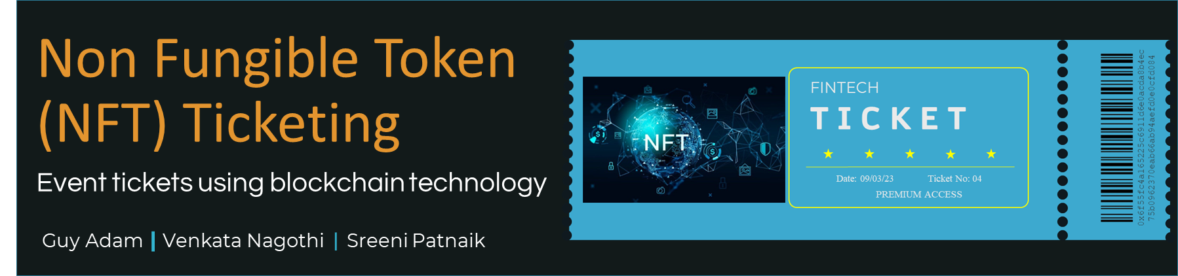
Readme Banner

Slide 18
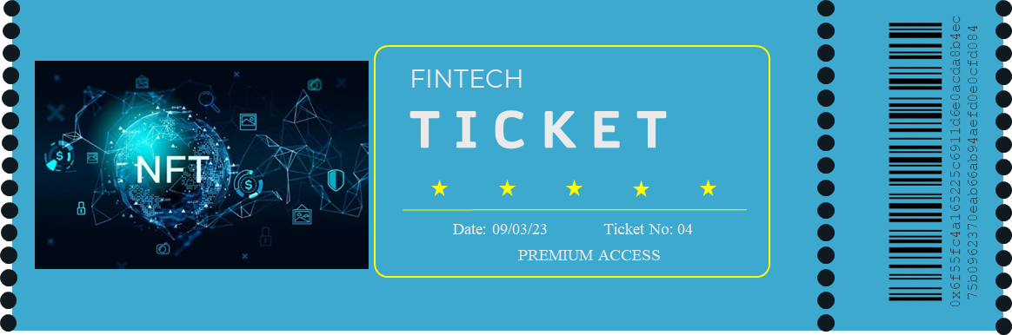
Our Approach
Include Relevant Code
Techniques
Unanticipated Insights
Include any relevant code or demonstrations of the analysis or application.
How did we Test and evaluate the code
Problems that arose and how were they resolved
Non Fungible Token
(NFT) Ticketing
Event tickets using blockchain technology
Guy Adam | Venkata Nagothi | Sreeni Patnaik

